Slide 1
Making e-business customer centric

Slide 2
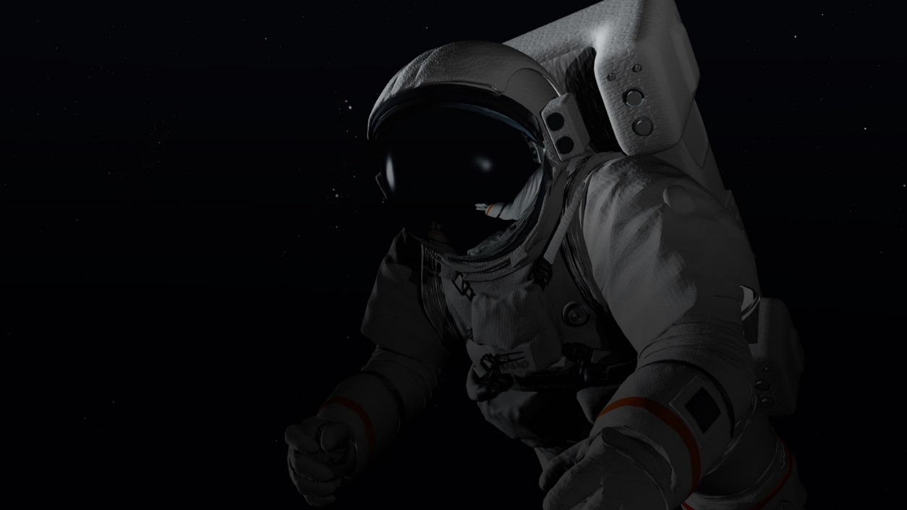
Our traction and achievements!
170+
e-businesses
2,500,000+
responses from customers

Slide 3
The shift of power
Power has been shifted to customers

Slide 4
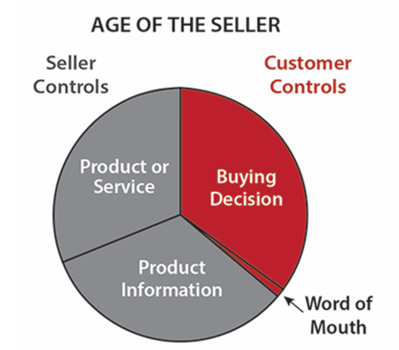
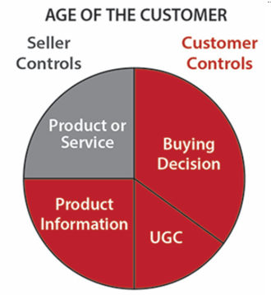
The world of e-business has changed
Power has been shifted to customers

Slide 5
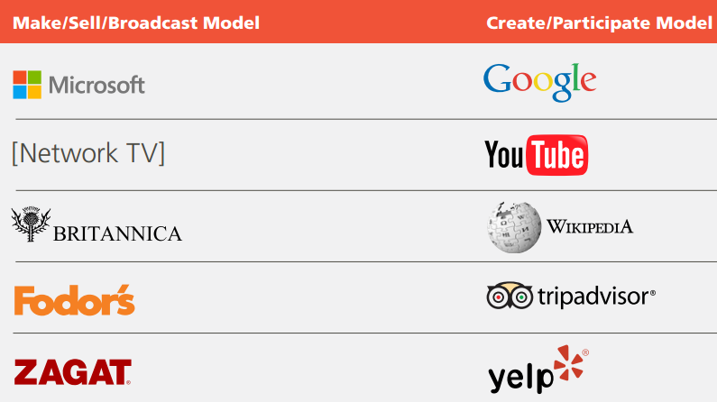
Examples of the shift
Institution Era
Human
Era
Centralized
Distributed
Broadcast
Participate
One way
Two way
Power
Trust
Notes:
Institution era companies like the ones shown on the left are loosing space over the human era companies shown on the right. The institutional era companies have some characteristics like Centralized, Broadcast, One Way and base their growth on their power, while on the other hand, human era companies are distributed, and the communication with customers goes two ways, based on mutual trust.

Slide 6
This is what we do every day
Google Search
Social Media / Social Ads
Content Marketing
YouTube Ads
Affiliate marketing

Slide 7
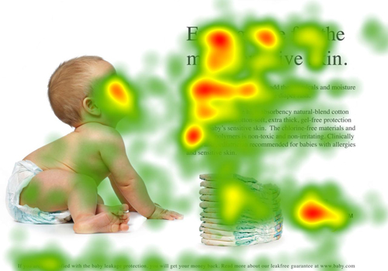
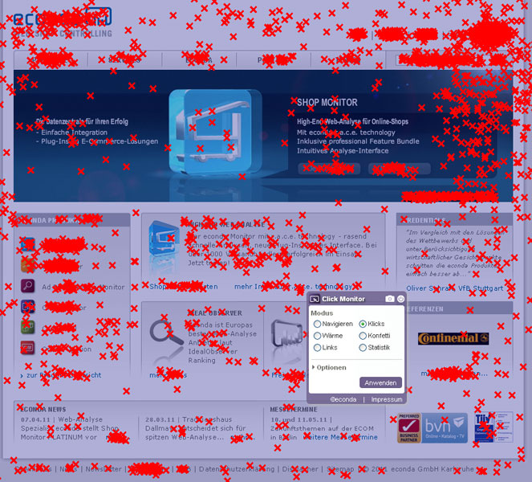
This is how we optimize

Slide 8
Food for thought
This is where we focus

Slide 9
What Human Era companies do to create bonds with customers!

Slide 10
Customer Experience Never Ends
Gartner Customer Experience Continuum

Slide 11
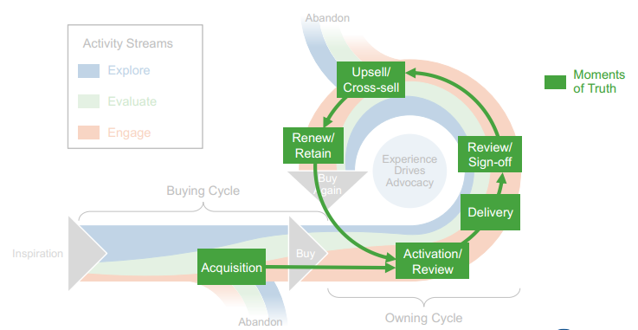
Moments of Truth in the Lifecycle
Moment of Truth
A time when
a person or thing is tested,
a decision has to be made
or a crisis has to be faced
Source: Gartner, 2016

Slide 12
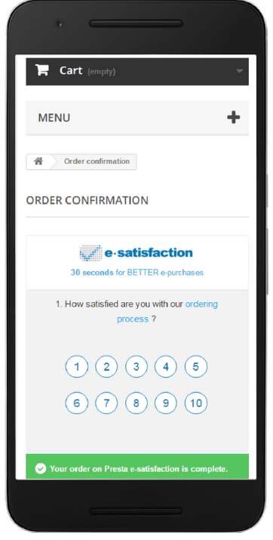
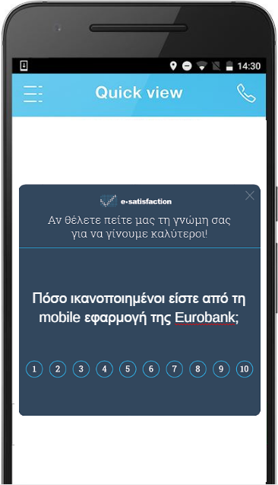
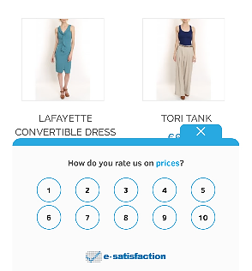
Moments of truth in retail e-commerce
Browsing
Checking Out
After Delivery / Pick Up

Slide 13
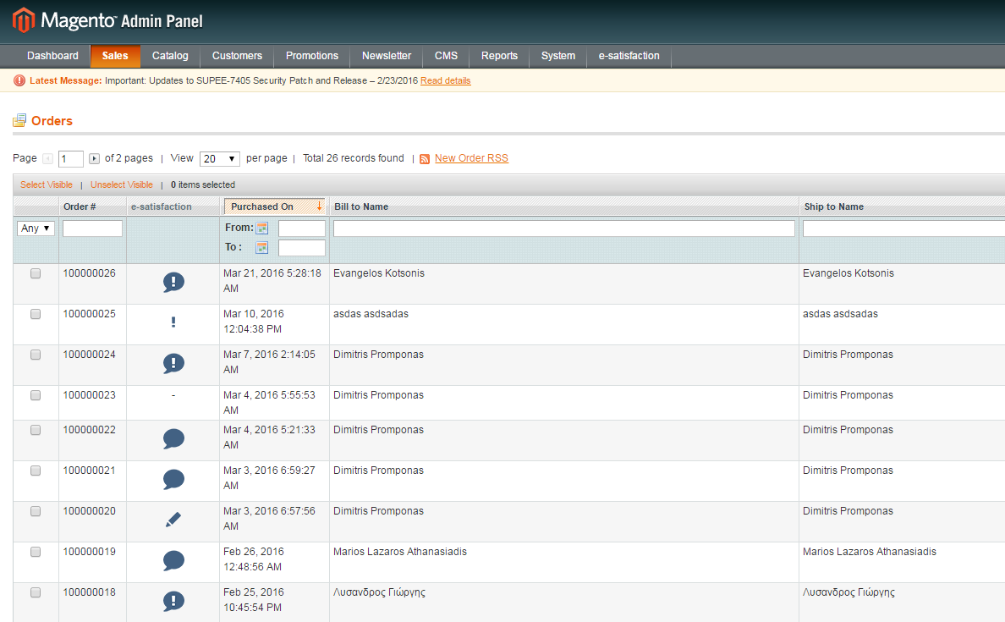
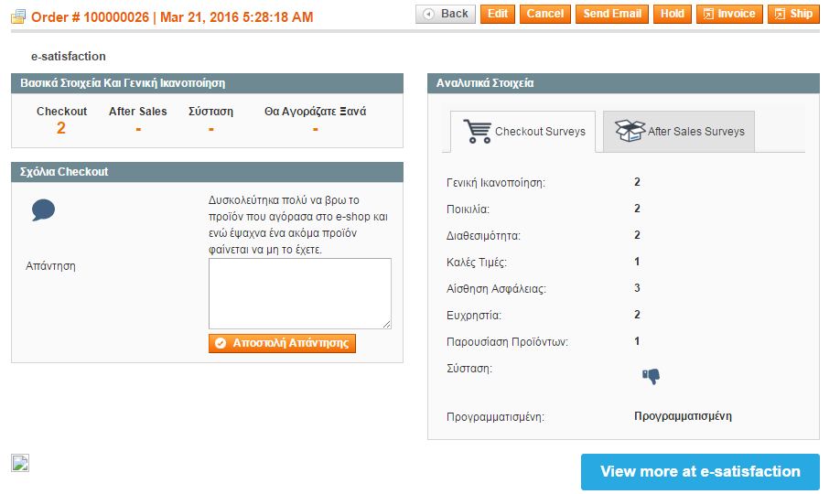
Make customer satisfaction a daily habit!
Which Orders need your immediate attention!
Orders with comments!

Slide 14
It starts with a question….
What do they need?

Slide 15
We used to explore customer segments…
What do they need?

Slide 16
Now it’s personal!
What do they need?

Slide 17
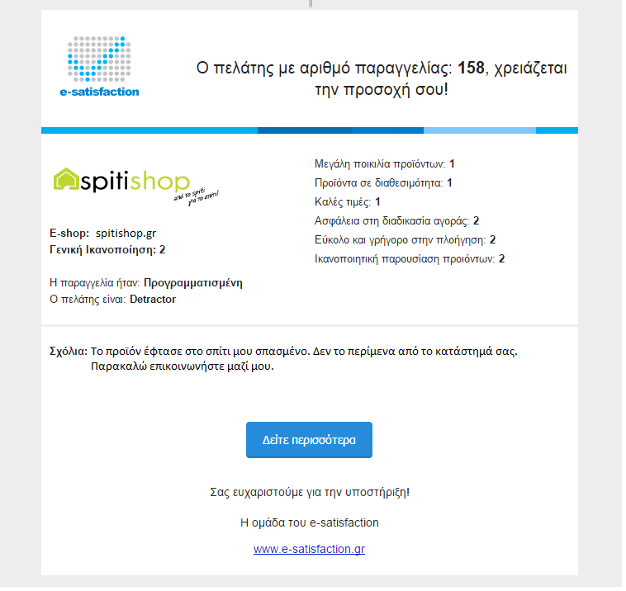
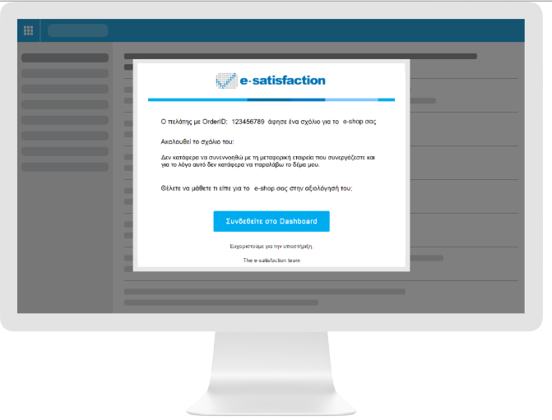
Automated Email alerts: Be notified when a customer has an issue!
Automated email alerts when a customers requires special attention, based on his feedback
25% reduction of call center cost

Slide 18
About e-satisfaction
the #1 humanized marketing platform
Notes:
We are the #1 Humanized Marketing Platform and we help e-businesses learn how customers feel, inspire them to act based on customer feedback, encourage them to invest on true customer needs to become profitable!

Slide 19
Build a real-time contextual consumer engagement engine
Discover
Explore
Buy
Use
Ask
Engage
Systems of insights
Systems of Engagement
Customer data
Interactions
Real time analytics
Marketing Automations
Insights
Source: Forrester, the Age of the Customer

Slide 20
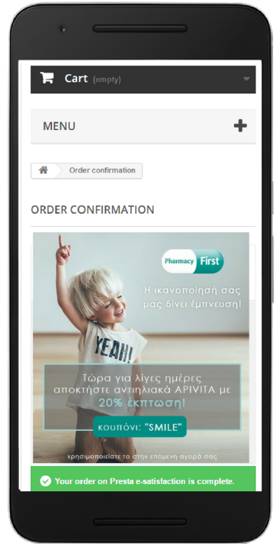
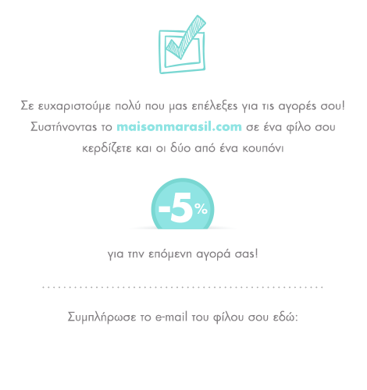
Refer a Friend: Positive Word of Mouth activation
Insights
Engagement
Refer a Friend
Promoter
28%
Refer a friend
Average Refer Rate

Slide 21
Call to Review: Increase Positive Word of Mouth everywhere!
Insights
Engagement
Promoter
20%
Call to review
Average Click Rate

Slide 22
Moments of truth in omnichannel commerce
Customer buys from a physical store
Just after leaving the store,
Receives a message
Evaluating Visit &
Purchase Experience
Generating Automated Personalized Campaign
using a loyalty card or provides email or phone number

Slide 23
Humanized Marketing Automations in Offline
CONTINOOUS
CREDIBLE FEEDBACK
OMNI INSIGHTS
REAL TIME ACTION

Slide 24
Take away thoughts!
Personalized
NOT audience-based or segment-based
The age of the customer
Interactive
NOT just informational
Technology enabled
NOT technology driven
Focused on value
NOT on short term revenue

Slide 25
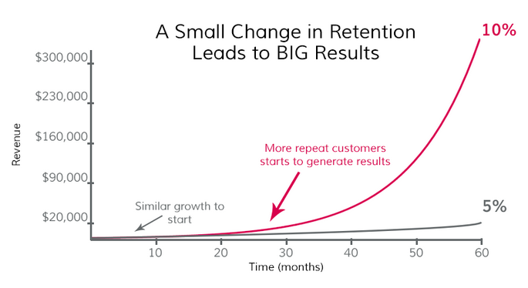
Takeaway thought in a chart…
% of Repeat Customers

Slide 26
Evangelos Kotsonis
ekotsonis@e-satisfaction.com
www.e-satisfaction.com
@esatisfactionGr
Thank you!

