Slide 1
Magento BI
Change your marketing strategy mentality

Slide 2
Basic Terminology
CPA: Cost Per Acquisition
CLV: Customer Life Time Value
AOV: Average Order Value
ROAS: Return On Advertising Spending
PROFIT: Profit ☺
Time To Market: The Time we need from the idea to implementation.

Slide 3
Find The CPA that fits better to you!
ROAS
PROFIT
CPA
0.5€
5€
10€
20€
50€

Slide 4
Which Campaign performs better?
Campaign A
CPA 3€
CLV 2.3
Campaign B
CPA 6€
CLV 2.8
AOV: 40€
AOV: 40€
Revenue: 2.3*40 = 92€
Revenue 2.8*40 = 112€
In other words 3€ more expensive CPA
may lead to 20€ more revenue only by
acquiring 20% better customers

Slide 5
Calculate CLV
#not

Slide 6
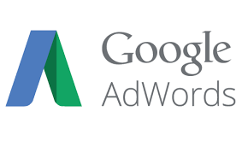

Slide 7
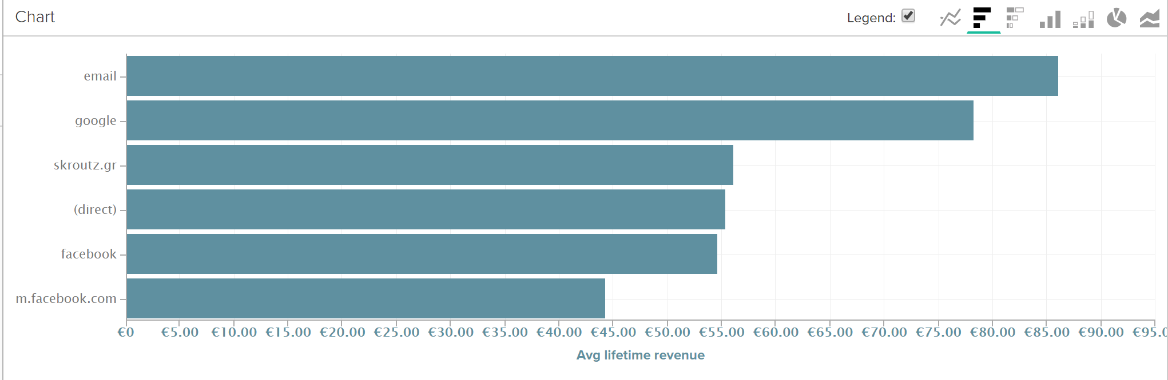
Customer Life Time Value per source

Slide 8
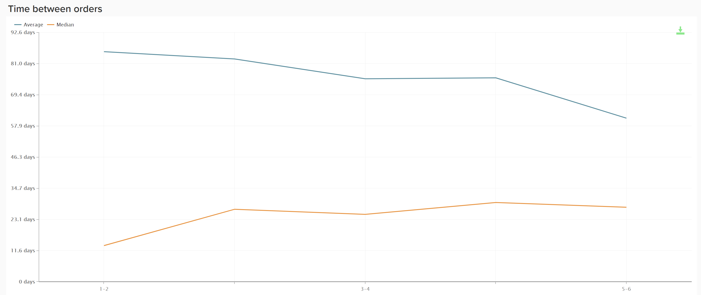
Time between orders

Slide 9
List of Coupon Lovers

Slide 10
Magento Business Intelligence
Great Tool to “learn from your data”
Inspire you to develop strategy
Answers to major Questions
What is my customer lifetime value?
What is the average period between orders?
What is my most profitable (in terms of CLV) channel?
What is my first time vs repeat revenue?
Affordable cost, really fast installation, zero learning curve

Slide 11
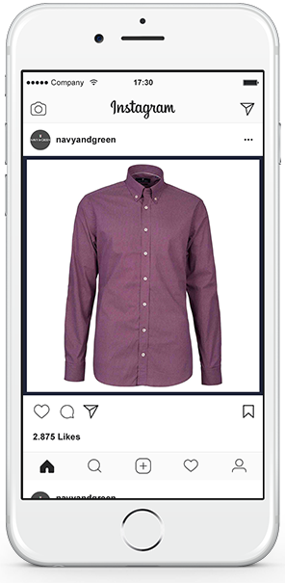
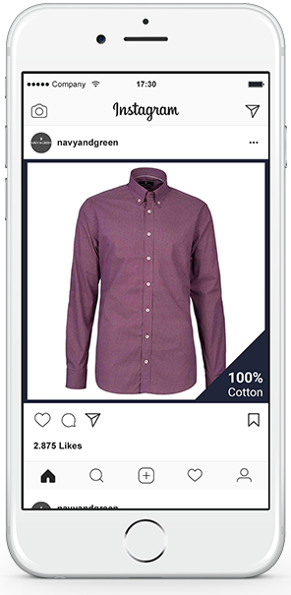
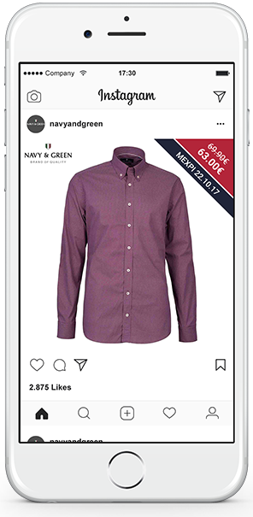
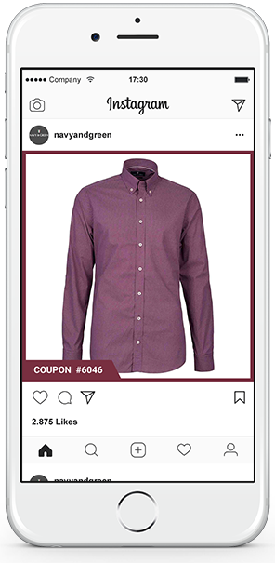
Example: Netsteps Retargeting Optimization

Slide 12
Barriers to digital commerce marketing
Lack of Strategy
Huge time to market
Too many tools/vendors
IT barriers

Slide 13
We already have enough Tools

Slide 14
Time To Market
How many agencies are involved in a strategy execution?
How much time do I need in order to implement a certain strategy?
What is my revenue and what will be the impact of super-duper tool to my revenue?
What is the communications working hours overhead and who pays for that?

Slide 15
Our Proposition: Be agile
Marketing
Technology

Slide 16
Thanks for Listening
Ioannis Karalis
Founder and CEO @ Netsteps S.A.
jkaralis@netsteps.gr
www.netsteps.gr

