Slide 1
Time is the enemy:
Ten Core Lessons for Achieving Peak
Performance in Magento
Leonidas Palaiokostas
Magento Certified Developer

Slide 2
Leonidas Palaiokostas Senior Software Engineer at EPIGNOSIS eLearning solutions Freelance Magento Developer & Consultant Magento Instructor (ATH/TECH College)
About Me

Slide 3
Fred Wilson: 10 Golden Principles of Successful Web Apps
“First and foremost, we believe that speed is more than a feature. Speed is the most important feature. If your application is slow, people won’t use it.”
500 ms Slower
400 ms Slower
100 ms Slower
20% drop in traffic
9% more people leave before page finish loading
1% drop in sales

Slide 4
Lesson 1 : Set correctly all Magento Configurations
Set Magento Environment to Production
Enable Flat Tables
Catalog category & Catalog Product
Remove unused stores
Single store mode
Restrict the number of products on category page
Enable CSS Merge and Minify option
Enable JS Merge, Bundling & Minify option
Minify HTML
Configure log lifetime & cleaning

Slide 5
Lesson 1: example
YSlow Statistics

Slide 6
Lesson 2 : Enable Caching
Enable Magento Cache
Enable Full Page Cache
Magento Embedded FPC
Varnish web application accelerator
Set up a cache warmer
Use key-value store
Redis
Memcached
Leverage browser caching

Slide 7
Lesson 2 : example

Slide 8
Lesson 3 : Optimize store’s images
Avoid large images in homepage
Resize images using command line
Optimize images
External services (e.g. TinyPNG)
Internal applications (e.g. jpegoptim, optipng, gifsicle)
Use images optimized for mobile devices.

Slide 9
Lesson 3 : example
TinyPNG (www.tinypng.com)

Slide 10
Lesson 3 : example

Slide 11
Lesson 4 : Optimize CSS/JS rendering
Move Render - blocking content to Footer
Defer parsing of Javascript
Combine images using CSS sprites

Slide 12
Lesson 4 : example
Facebook Sprites

Slide 13
Lesson 5 : Use CDN (Content Delivery Network)
Use CDN for static content
Javascript & CSS
Fonts
CSS images & sprites
Use CDN for Images
Catalog Images

Slide 14
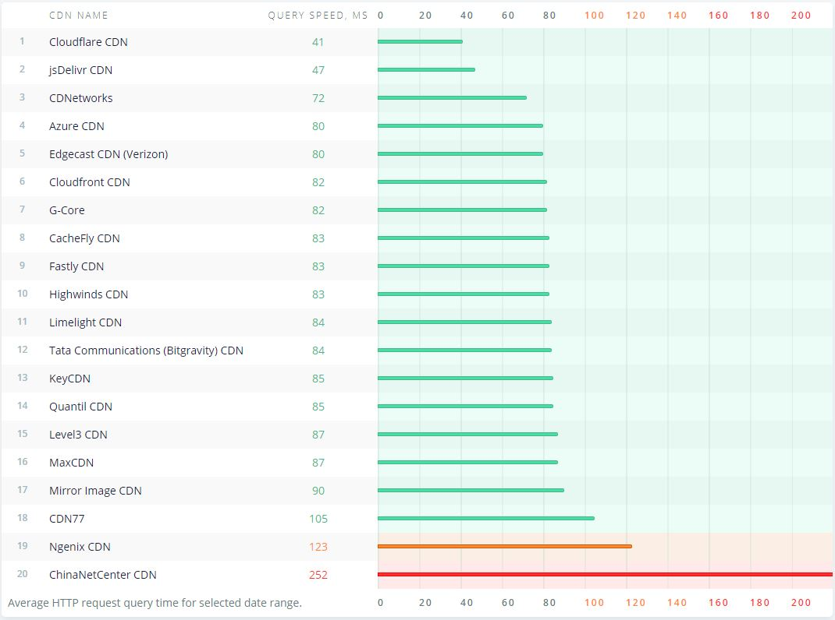
Lesson 5
CDNPerf.com – CDN comparison for Greece

Slide 15
Lesson 6 : Optimize modules & code
Uninstall all extensions you don’t really need
Remove debug logs
Decrease size of cookie
Prefer asynchronous resources
Make Ajax requests cacheable
Make unit tests
PHP → PHPUnit
Javascript → Jasmine & JsTestDriver

Slide 16
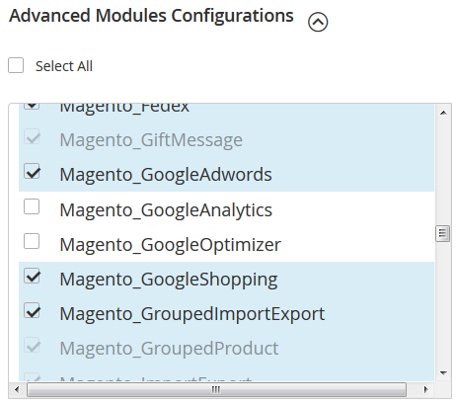
Lesson 6 : example
Magento Installation 4th Step: Customize Your Store

Slide 17
Lesson 7 : Configure Server properly
Enable PHP Opcache
Use PHP 7 instead of 5.6
HHVM?
PageSpeed Module
Compress components with gzip
Set Cache-Control max-age depending on file type
SSL + HTTP2
Load only required Apache modules

Slide 18
Lesson 7

Slide 19
Lesson 8 : Use Search Engine
Use a Search Engine (server)
ElasticSearch M2EE
Apache SolR
Sphinx

Slide 20
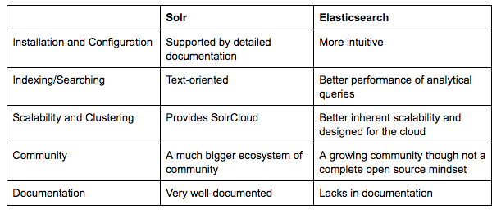
Lesson 8
ElasticSearch Vs Apache SolR

Slide 21
Lesson 9 : Tweak Database
Try a MySQL replacement
MariaDB
Percona
Use separate web & database servers
Use query caching
Optimize DB setting to fit website’s needs
MySQLTuner Tool

Slide 22
Lesson 9 : example

Slide 23
Lesson 10 : Choose the right hosting provider
Magento Commerce (Cloud)
Magento optimized hosting

Slide 24
Bonus Lesson : Monitor your store
Monitoring
New Relic
Performance tools
jMeter
Backfire

Slide 25
Thank you!
Leonidas Palaiokostas
Magento Certified Developer
l.palaiokostas@yahoo.com
https://github.com/sfmedion

