Slide 1
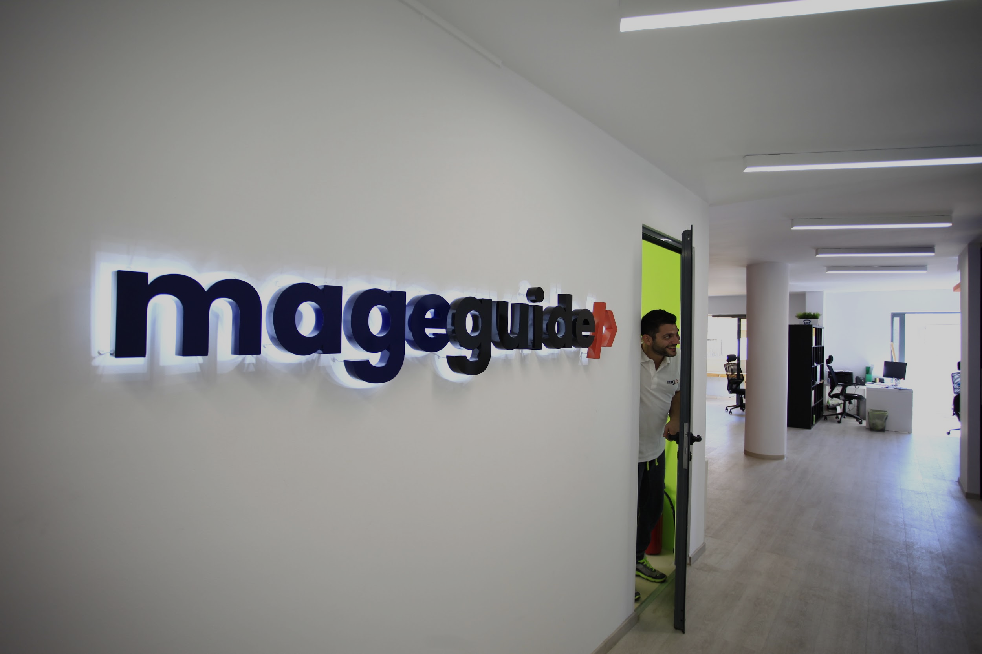
Notes:
Insert picture/right click/send to back

Slide 2
HELLO
I am Mits – CEO of MageGuide

Slide 3
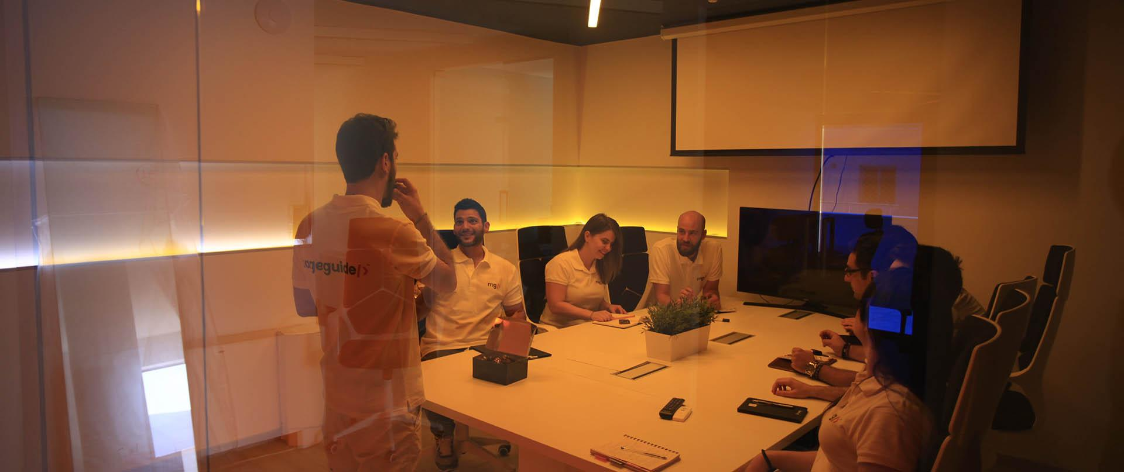
We're a team of creative and computer science gurus. We're truly enthusiastic about what we accomplish every day, and we enjoy working with clients that demand excellence and are equally passionate about their business.

Slide 4
Magento Extensions
Latest extensions

Slide 5
Provide a better UX
to our customer navigation flow
Increase our Magento CR
through the checkout process
Take advantage of mobility
through magento design architecture
MISSION
Notes:
Insert picture/right click/send to back

Slide 6
Opti-prioritisation?#!
Don’t only pay to get your visitors back, just don’t let them go.
1
2
Cost-effective
Day one: money back
way to increase your sales
Immediate impact on your pocket
3
4
Customer Satisfaction
Numbers.
is no1 factor for loyalty
Data collection is always a pro

Slide 7
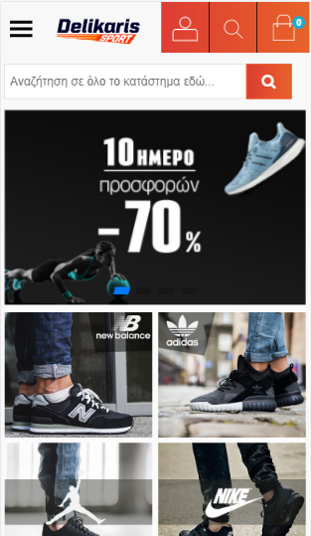
THE SILENT KING
Mobile Version
On high-traffic websites, more than 65% of visits come through mobile devices.
An exclusive version for mobile users can increase your ATC rates immediately.

Slide 8
Mobile vs Responsive
What’s the difference
User Experience
Better Load Time
Built only for mobile users
No need to load every website element
Organic results
Better ads score
seo tactic
increase ads position
(overall)
Higher CR
A/B Testing
it means also lower CPA
(overall)
Easier functional tests

Slide 9
Checkout
improving the interaction drives us to more sales
visual
action

Slide 10
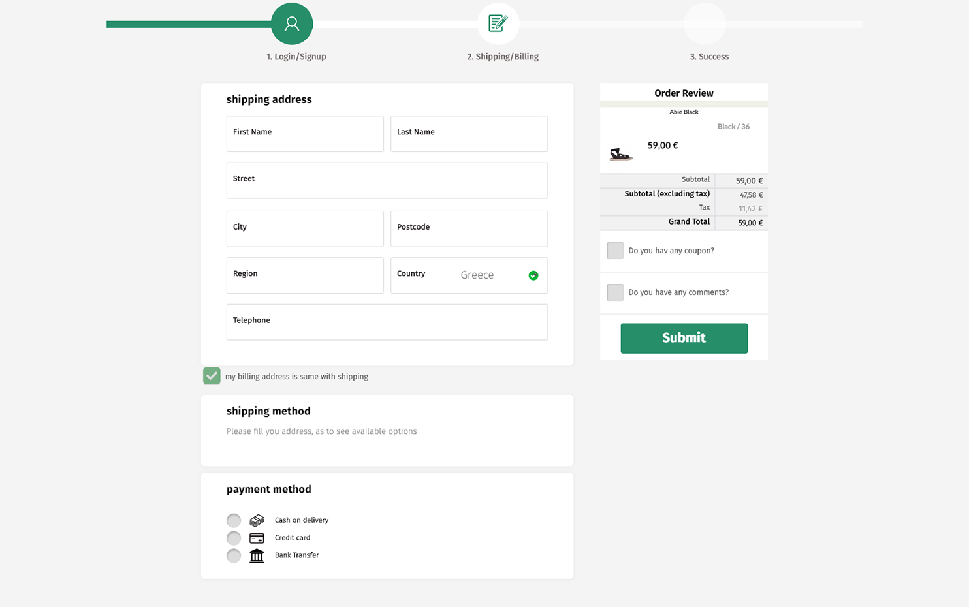
Visual
from information to action
Is customer able to find what he needs ?
Do we need the step navigator ?
Is our users quite experienced or not?

Slide 11
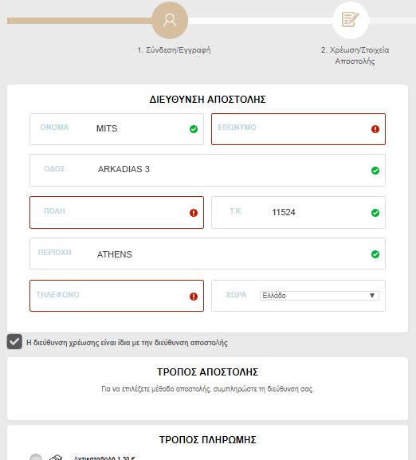
Action
interaction to checkout
Auto-register (less-fields strategy)
Smart validation
Auto-apply coupon (this really helps u!)

Slide 12
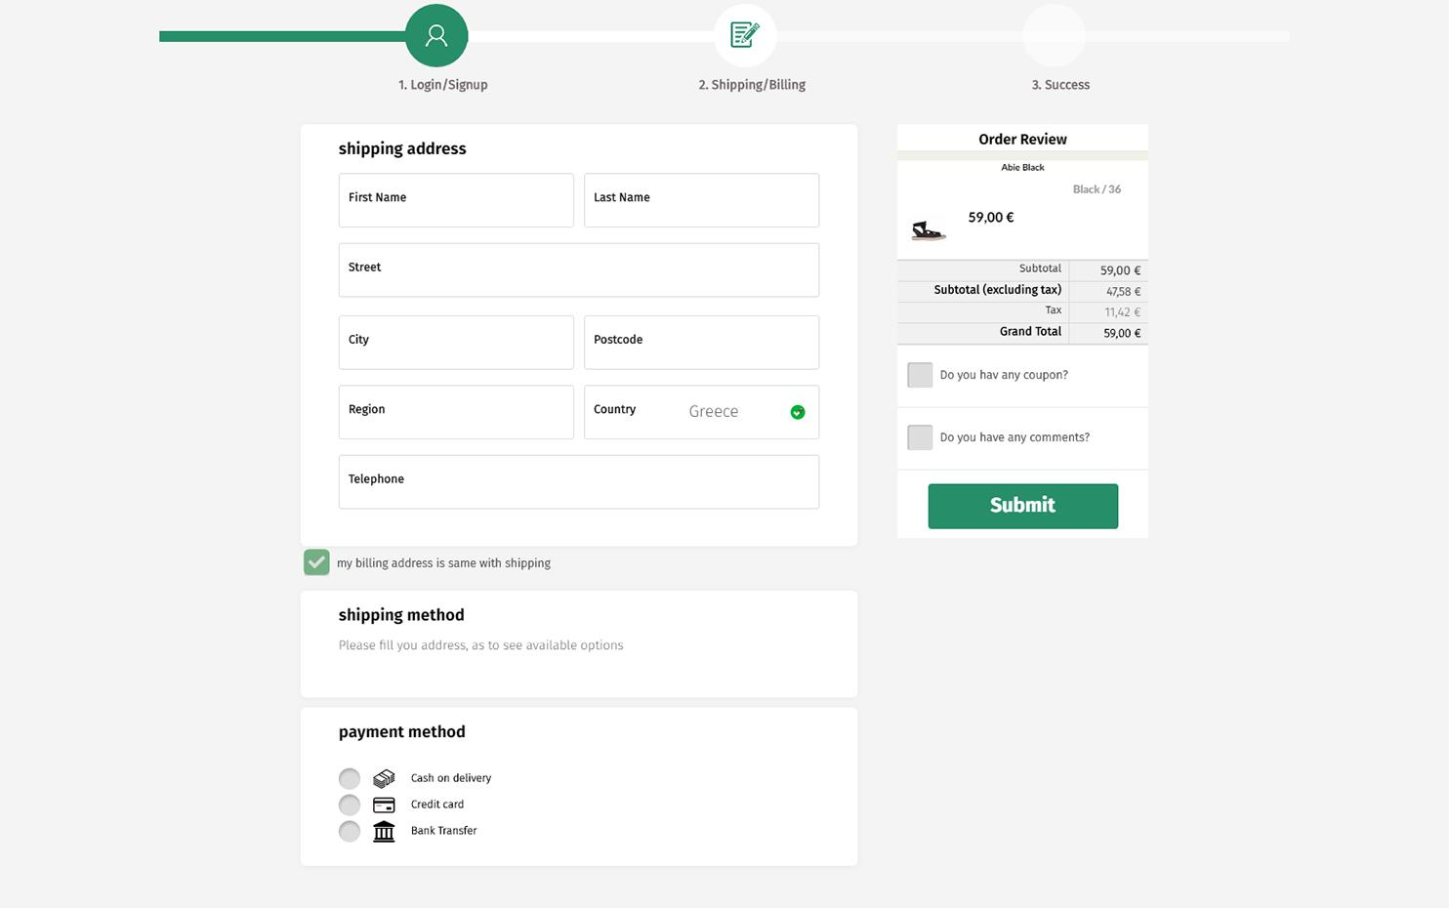
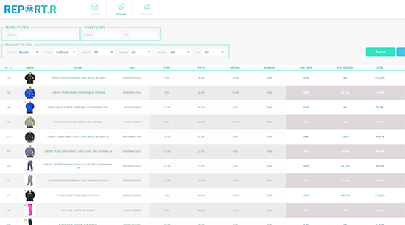
-35% abandoned carts
Tricky interface
Smooth customer navigation
More efficient results
01
Metrics drive you
Advanced stock/sales reports
Realistic cost of sold items (cpa)
Smart notifications
02

Slide 13
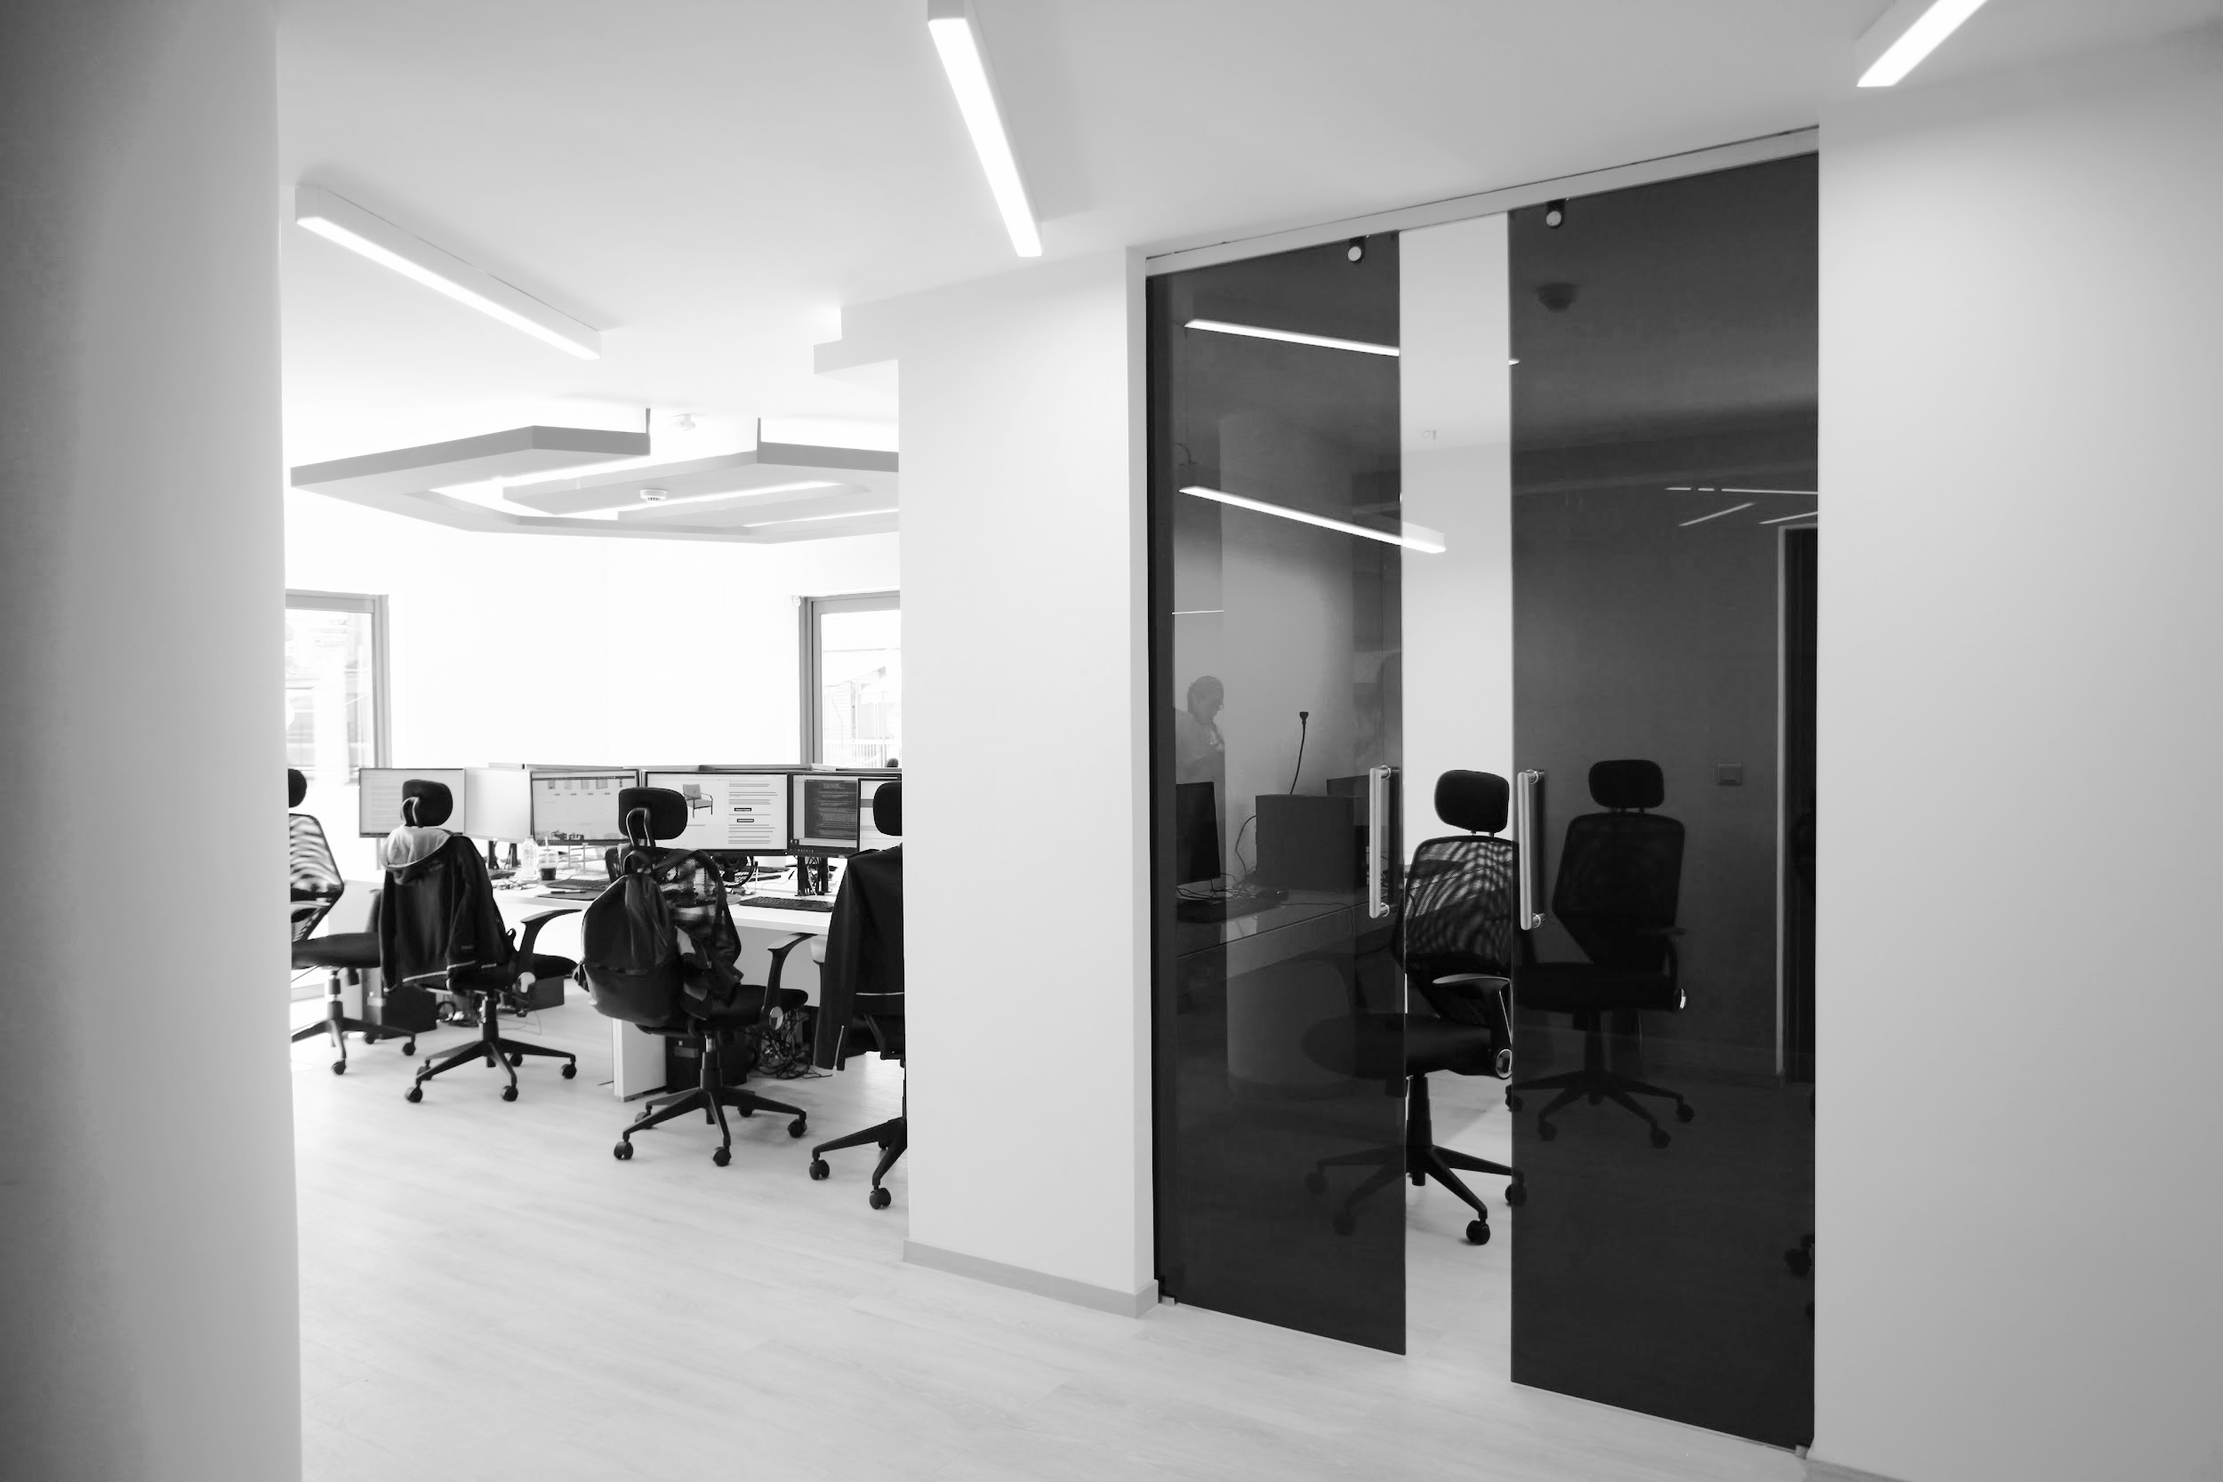
What’s next
for the following months

Slide 14
Data-driven decisions
A/B Testing
Reporting
Smart messages
.
Magentiser
Facebook Audiences

Slide 15
MAGENTO 2
what to expect from us on M2
Automations
Personalisation
PWA
(progressive web apps)

Slide 16
Thank you!
www.mageguide.com | (30) 2111 822 777 | info@mage.guide

